Slide 1
Social Network Analysis (SNA)
🌏

Slide 2
Introduction:
Social network analysis (SNA) is a process of quantitative and qualitative analysis of a social network. SNA measures and maps the flow of relationships and relationship changes between knowledge-possessing entities. Simple and complex entities include websites, computers, animals, humans, groups, organizations and nations.

Slide 3
Background History
Social network analysis has its theoretical roots in early sociologist such as Georg Simmei and Emile Durkheim who worked and wrote about the importance of studying patterns of relationships that connect socially.
In the 1930s Jacob Moreno and Helen Jennings introduced basic analytical methods.
In 1954, John Arundel Barnes started using the term systematically to denote patterns of ties.
Scholars such as Ronald Burt, Kathleen Carley, and Harrison White have become part of it and expanded the use of systematic Social Network Analysis.

Slide 4
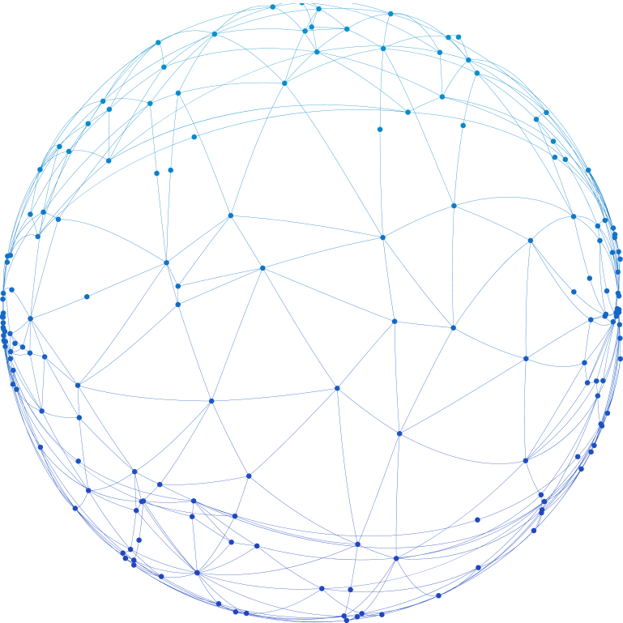
Importance of SNA
Social network analysis in general studies the behavior of the individual at the micro level, the pattern of network structure at the macro level, and the interactions between the two.
Social Network Analysis is found in various applications such as:
Social Media Connectivity
Mapping of Connections
Marketing
Crime Investigation
Cyber Security

Slide 5
Marketing
Many businesses use networking as a key factor in their marketing plan. It helps to develop a strong feeling of trust between those involved and play a big part in raising the profile of a company.
Now-a-days marketers use social networking for increasing brand recognition and encouraging brand loyalty.
For example:
A frequent Twitter user may hear of a company for the first time through a news feed and decide to buy a product or service.
Customers may complement the company’s offerings and encourage others to buy the products or services.
A company may use social networking to demonstrate its customer service level and enrich its relationships with consumers.

Slide 6
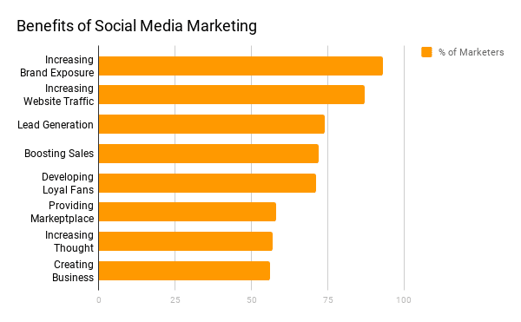

Slide 7
Criminal Activity

Slide 8
Cyber Security
Cyber-attacks are critical cyber-security concerns across the world. Catching malicious hackers prior to a cyber-attack can save significant financial cost as well as avoid devastating cyber-attacks. This is where SNA comes in handy;
SNA can help detect misinformation in online social networks in the early stage of spread.
Detection of intruder’s communities: such as terrorists, tracking malicious activity.
Help crime investigators pinpoint the location of malfunctioning source.

Slide 9
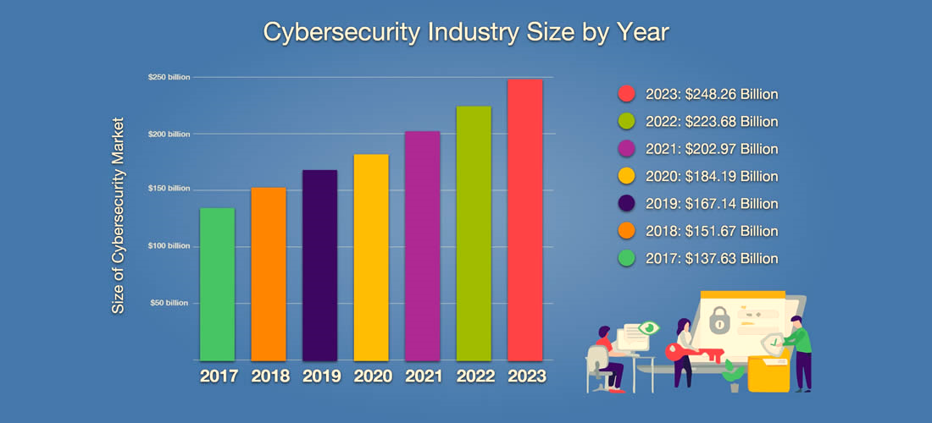

Slide 10
Social Media Connectivity
Social Networking sites like Facebook uses applications of Social Network analysis to identify and recommend potential friends based on friends-of-friends.
Network operators (Telephone, Cable and Mobile) use SNA-like methods to optimize the structure and capacity of their networks.
Companies uses SNA to analyze and improve communication flow in their organizations, or with their networks of partners and customers.

Slide 11
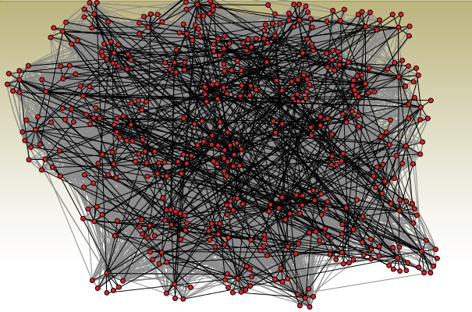
Organizations

Slide 12
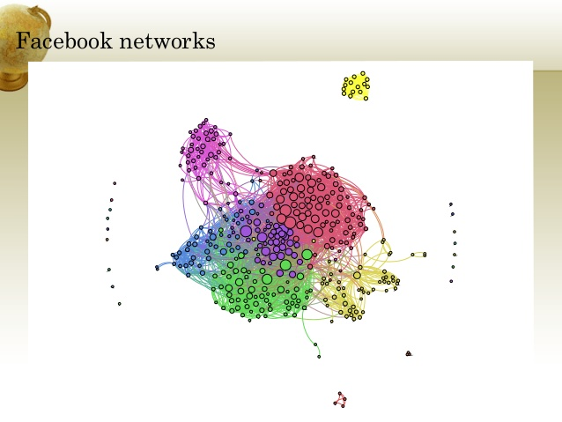
Facebook Networks

Slide 13
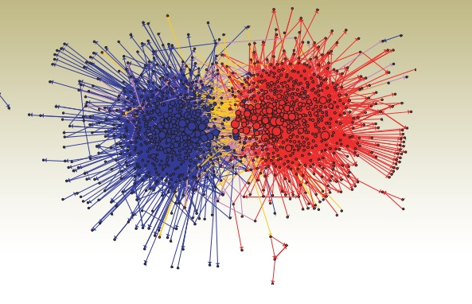
Political Blogs

Slide 14
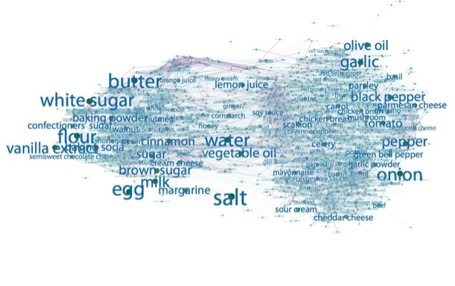
Ingredient Networks

Slide 15
Map
\

Slide 16
7,789,526,124
Number of people connect through Social Networks.

Slide 17
7,789,526,124 users
$39,412,523,304
100%
That’s a lot of users
And that’s a lot of money
Total success!

Slide 18
Conclusion
The Social Networking is now the most frequent tool used in today-human-life. It is widely used in business marketing, social connectivity, cyber system, academic purpose and other various platforms. The SNA provides a platform for people to mutually connect and express and exchange their ideas and views. The research is still in progress to ensure the safeguard of one’s information and data.

Slide 19
Thanks!
Any questions?
You can find us at:
k191043@nu.edu.pk (Salman Ahmed)
k191048@nu.edu.pk (Amman Soomro)
👦
👦

